Slide 1
use of sample superstore dataset in short in one paragraph
Sample - Superstore
use of sample superstore dataset in short in one paragraph
Objective :
The Sample Superstore dataset, comprising essential order details like Order ID, Order Date, Ship Date, Ship Mode, Customer Segment, Product Category, Sub-category, along with customer-related information such as Customer ID, Name, Postal Code, and comprehensive product details like Product Name, Sales Amount, Quantity Sold, Discount, and Profit Margin, serves as a holistic repository for detailed retail analysis. This dataset facilitates comprehensive insights into sales trends, customer behavior analysis, operational efficiency assessments, and strategic decision-making. By utilizing this extensive dataset, businesses can derive actionable insights, optimize sales strategies, enhance customer experiences, and improve overall operational performance within the retail landscape.
Efficiently clean and preprocess the Sample Superstore dataset to ensure data integrity. Create visually engaging and interactive dashboards using Power BI, incorporating diverse visualizations, DAX queries for insightful calculations, and a decomposition tree to analyze hierarchical data. Implement forecasting models to predict future sales trends, empowering stakeholders to derive actionable insights for informed decision – making.

Slide 2
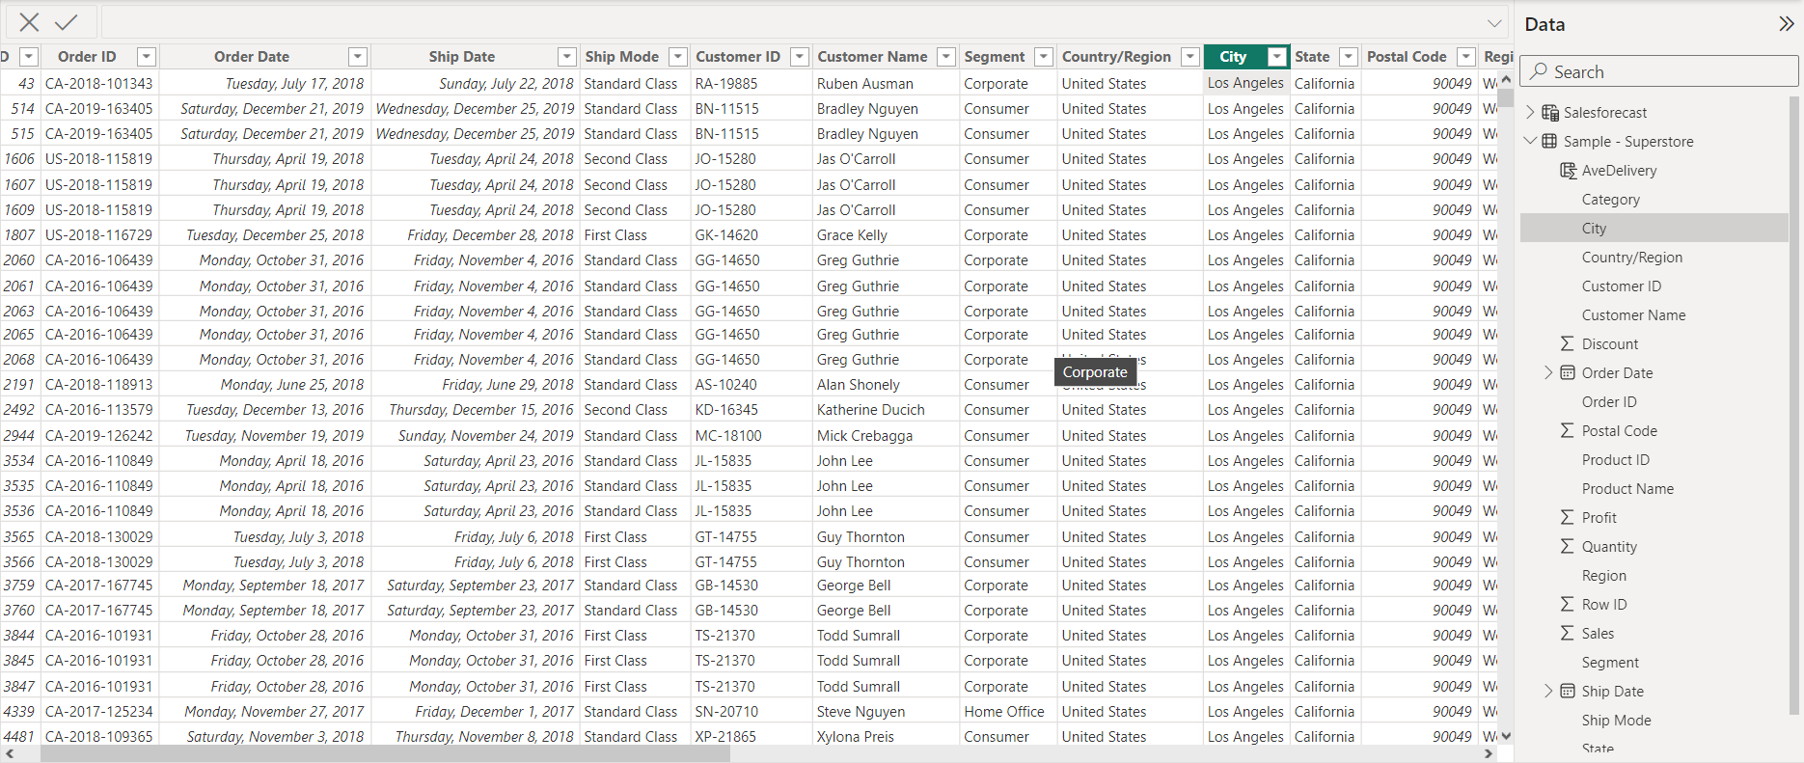
Data View : -

Slide 3
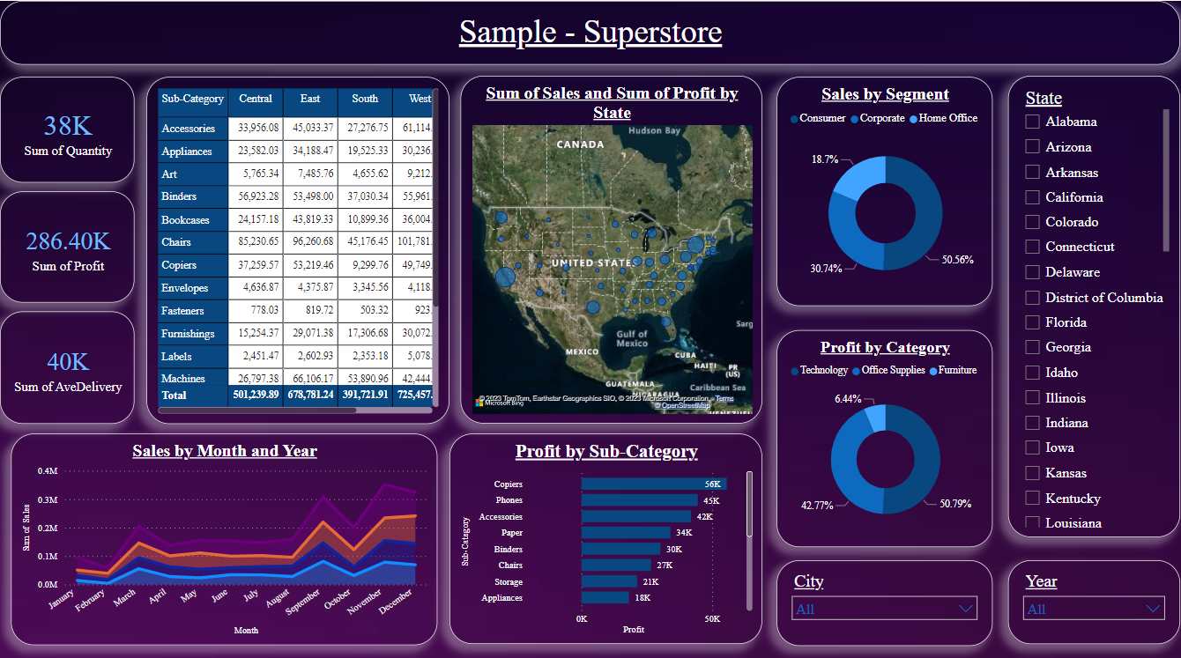
Report View : -

Slide 4
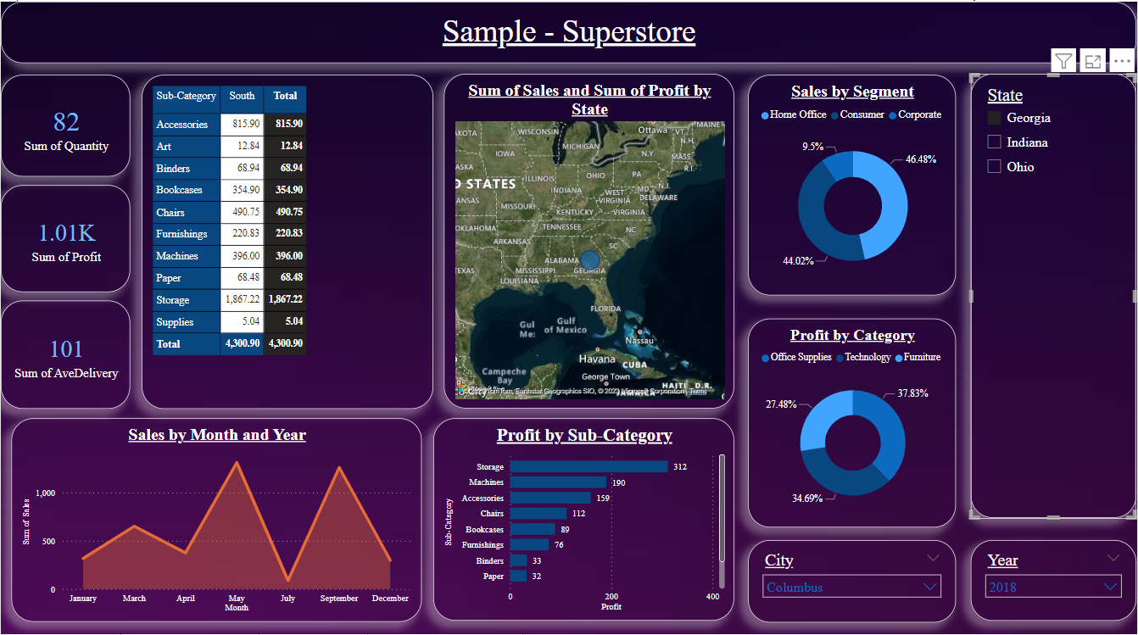
Georgia State Data : -

Slide 5
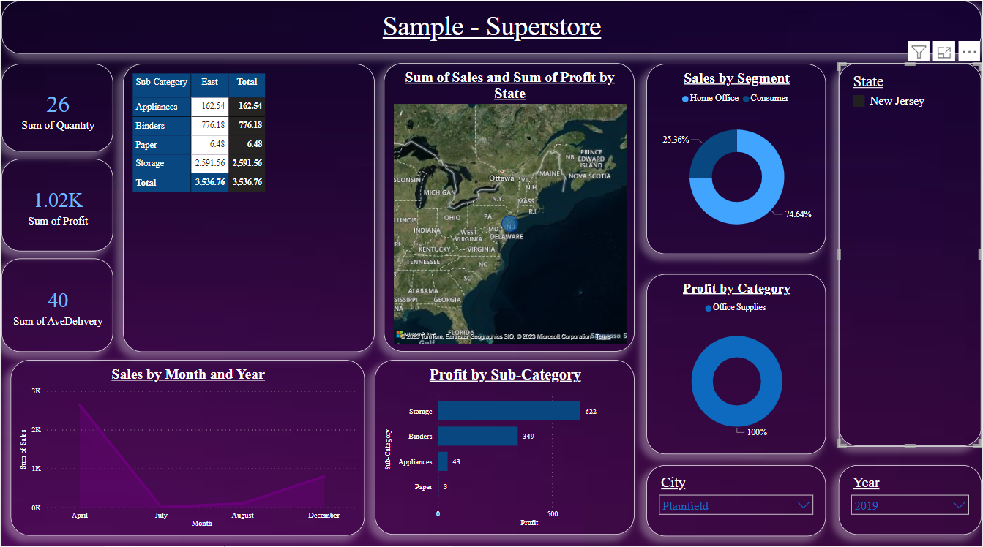
New Jersey State Data : -

Slide 6
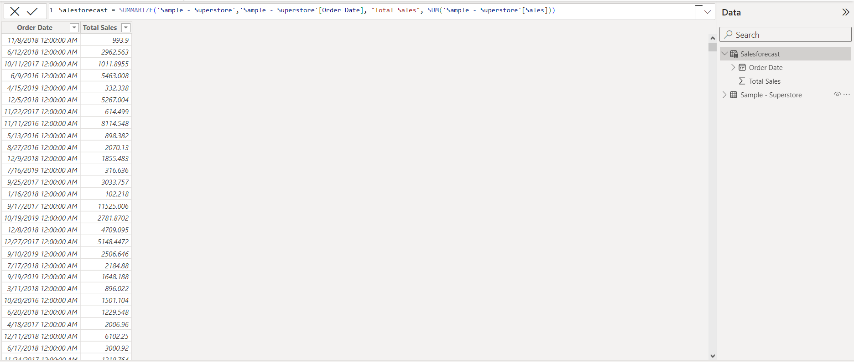
Forecasting Data View : -

Slide 7
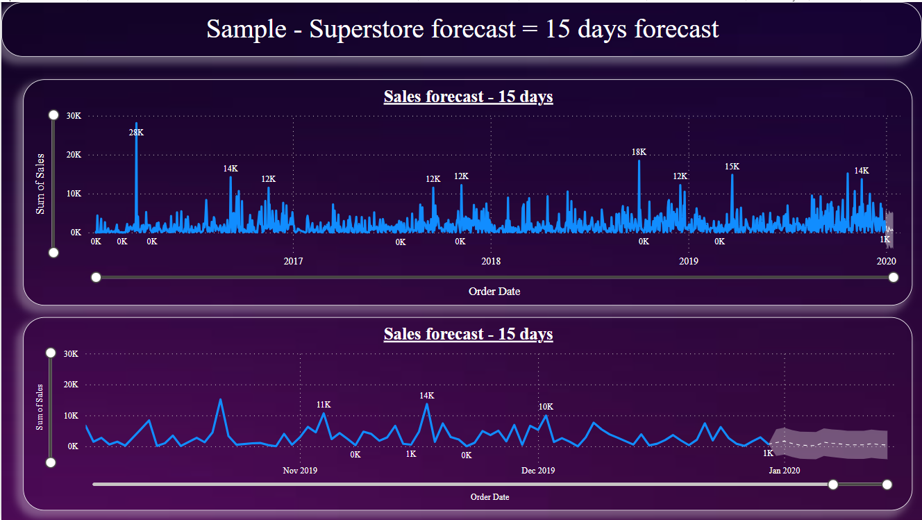
Forecasting : -

Slide 8
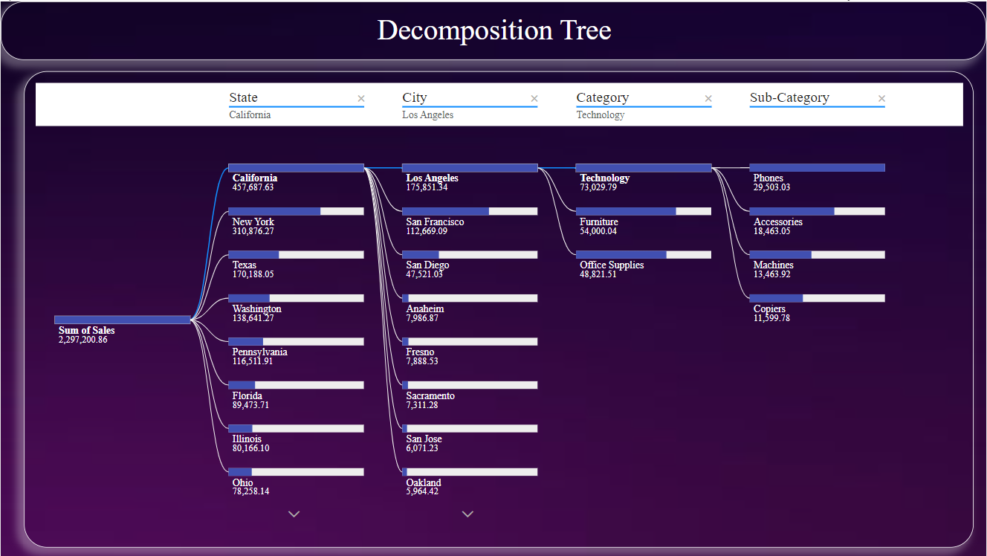
Decomposition Tree : -

Slide 9
